Slide 1
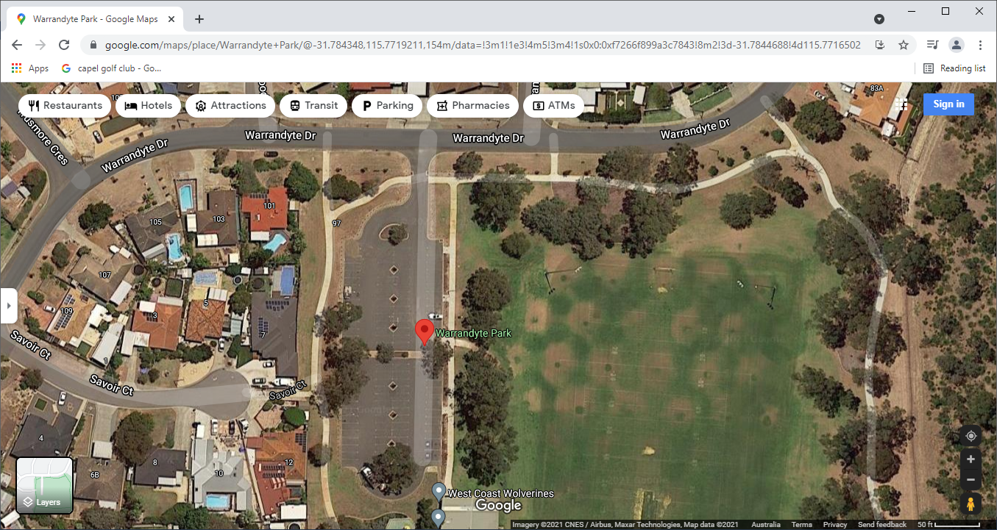
Operation arra
Warrandyte Park
Clubroom
Warrandyte drive
Container Set up
Operation area

